Slide 1
Show me your code and...
salankiv… alias Viktor

Slide 2
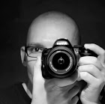
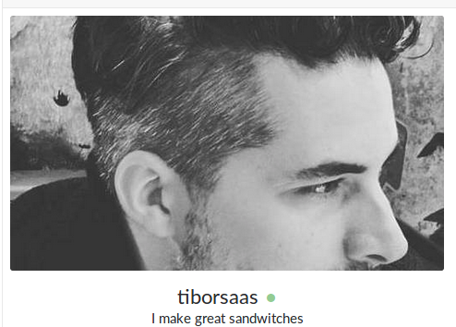
Two developers, one task
VS.

Slide 3
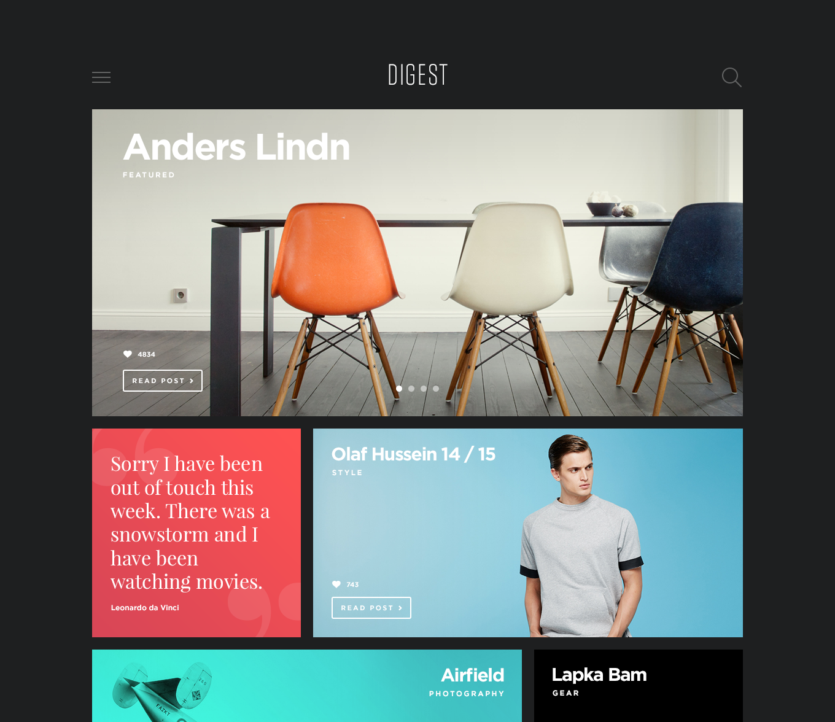
Task #1

Slide 4
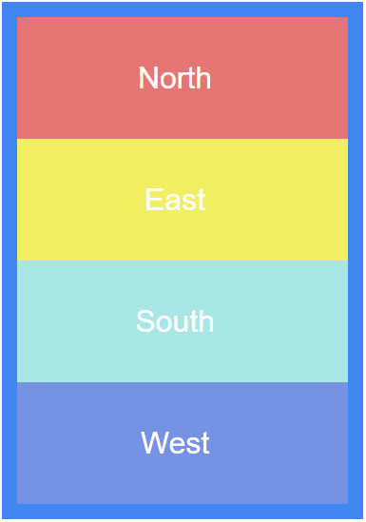
Task #2

Slide 5
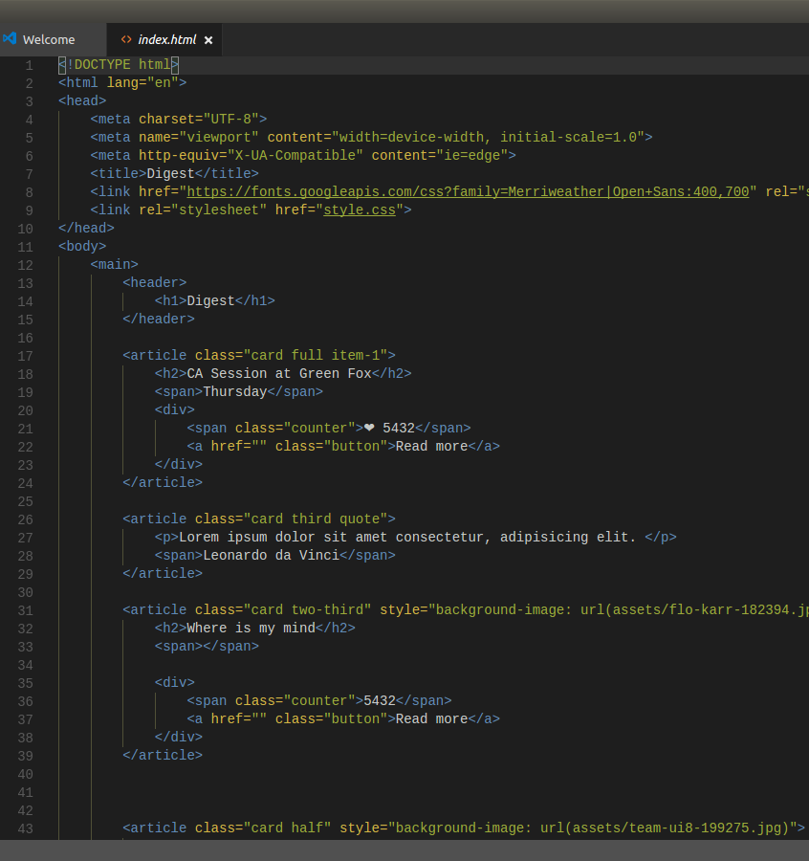
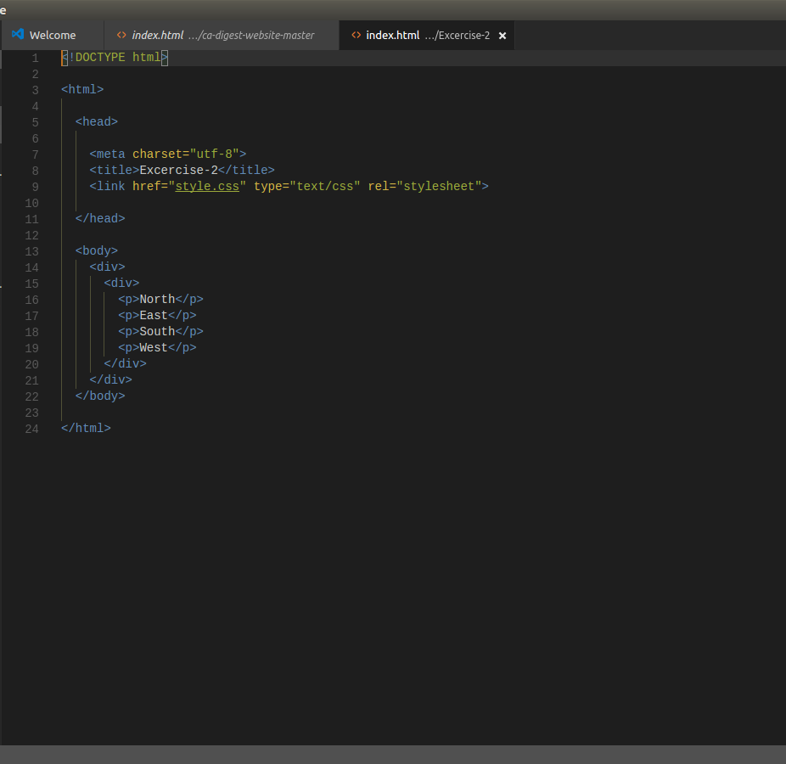
HTML codes

Slide 6
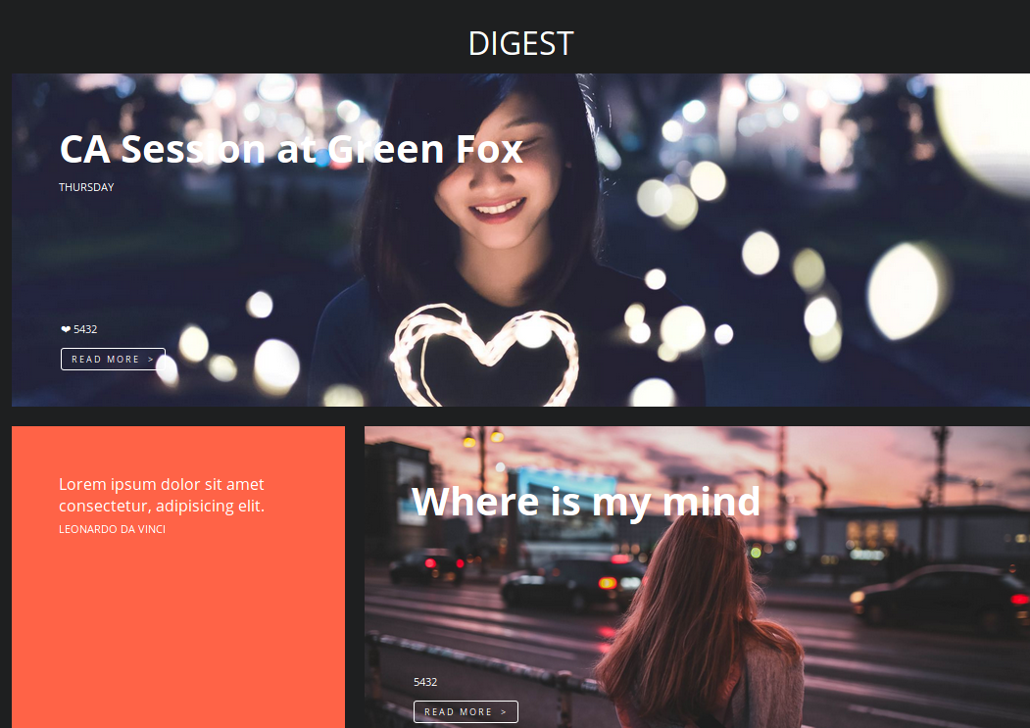
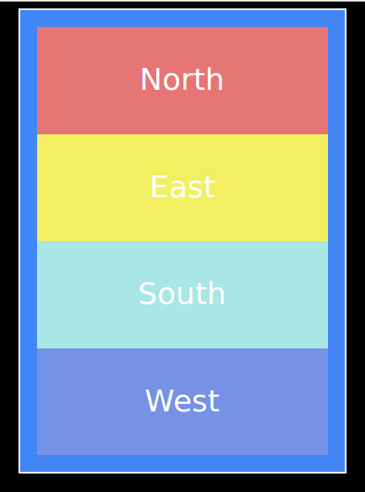
Results

Slide 7
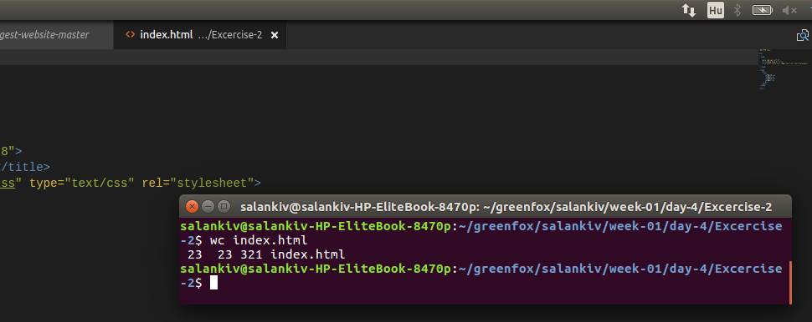
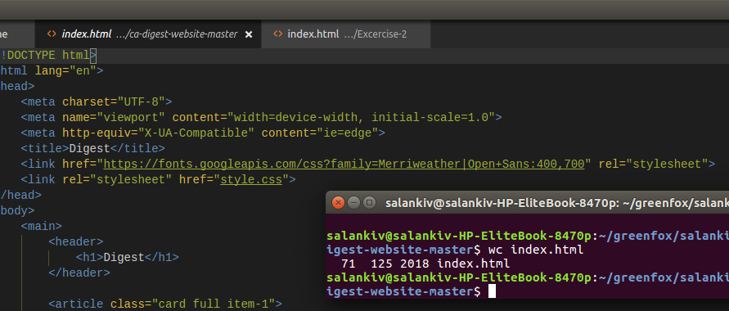
Statistics

Slide 8
Some more statistics
Time used for task:
40 min
90 min
Most frequently used keyboard buttons:
Shift / Ctrl
Backspace / Delete
Internet usage:
google.fonts
How do I...

Slide 9
Learning
Shortcuts
Shortcuts
… and shortcuts

